Slide 1
Markov Random Field Notes
A Little Theory and Lots of Computation*
*Or more formally: Understanding and Operationalizing Markov Random Fields to Model Dependencies Between Discrete Random Variates

Slide 2
Great background material for Markov Random Fields from which the Notes below are derived:
Chapters 4 and 20 Koller and Friedman:
Probabilistic Graphical Models: Principles and Techniques
Gould Notes:
https://users.cecs.anu.edu.au/~sgould/papers/part1-MLSS-2011.pdf
**UGM (Schmidt):
https://www.cs.ubc.ca/~schmidtm/Software/UGM.html
**CRF: Port of UGM for R (Wu)
https://github.com/wulingyun/CRF
Murphy Chapter 19:
https://www.cs.ubc.ca/~murphyk/MLbook/pml-print3-ch19.pdf
Kschischang et al.:
Factor Graphs and the Sum-Product Algorithm, IEEE Transactions on Information Theory Volume: 47, Issue: 2, pp 498-519, 2001

Slide 3
My little add on R package to do some stuff in these Notes can be found at:
To install in R, run the lines:
https://github.com/npetraco/CRFutil2
# First install remotes and some packages now only available on Bioconductor
install.packages("remotes")
install.packages("BiocManager")
BiocManager::install("graph", force = TRUE)
BiocManager::install("Rgraphviz", force = TRUE)
BiocManager::install("RBGL", force = TRUE)
# Turn on remotes and install CRFutil2 from github
# CRFutil2 should automatically install CRF and gRbase:
library(remotes)
install_github("wulingyun/CRF")
install_github("npetraco/CRFutil2")
# Test and see if the CRFutil2 library loads. No error messages
# is a sign of success. Don't worry about any warning messages.
library(CRFutil2)
scr_install.R
Note: CRFutil2 is meant to be pedagogical…

Slide 4

Math and equations are nice, but you only really understand a theory or a model when you program it and get concrete numbers out.
This is the purpose of these Notes
Pedagogical (and occasionally fast) implementation of Markov random field (MRF) concepts discussed in these Notes are contained in CRFutil2, which piggybacks off the very nice CRF* library by Wu.
Important or particularly pedagogical implementations in CRFutil2 have a clickable link to the code (cf. e.g. this).
*CRF is no longer actively maintained on CRAN, but it is archived there. To further preserve it and to maintain CRFutil2 to teach with, I’ve forked Professor Wu’s last update of CRF on GitHub, which was in 2019. This link points to my fork.

Slide 5
Also, there are many R scripts in these Notes to demonstrate MRF related concepts.
Each script is labeled with a unique name starting with the letters scr. To pull them up use the get_script() function from the CRFutil2 library.
As an example, pull up the first script we’ll encounter: scr1.R:
unique script label
library(CRFutil2)
get_script("scr1.R") # Pull up the script. It's that easy!
scr_gsd.R

Slide 6
Table of Contents
Markov Random Fields: Theory and Computation - 7
Maximum Likelihood Approximation for MRF Parameters - XX
Maximum Pseudolikelihood Approximation for MRF Parameters - XX
Multilevel Logistic Regression to Determine MRF Parameters - XX
Log-linear approach to for MRF Parameters - XX
Message passing and belief propagation - XX
XX

Slide 7
For some joint probability distribution over a set of variables* , Pr(X):
The dependencies between the X_{i} can be represented as a graph.
An example for a 5-variable distribution Pr(A,B,C,D,E)
A
A 5-variable PMF with dependencies represented by an undirected graph (Markov Random Field or Markov Network)
E
B
D
C
*We’ll assume variables are discrete unless stated otherwise

Slide 8
Parameterize this distribution using unary potentials for each node and pair-wise potentials between each pair of connected nodes*
For the example Pr(A,B,C,D,E) this amounts to replacing the undirected graph with a factor graph
*We’ll assume all MRFs in these notes are parameterized this way unless otherwise stated
Ψ_{A}
A
Ψ_{AE}
Ψ_{AB}
E
B
Ψ_{E}
Ψ_{BE}
Ψ_{B}
Ψ_{AD}
Ψ_{DE}
Ψ_{AC}
Ψ_{BC}
Ψ_{BD}
D
C
Ψ_{D}
Ψ_{BD}
Ψ_{C}

Slide 9
The Ψ_{i} and Ψ_{ij} are factors or potentials. They are functions representable in table form which hold (usually) un-normalized quantities which contribute to the joint probability distribution:
Ψ_{i} are called unary or node potentials and Ψ_{ij} are called pair or edge potentials.
Edge potentials are known as transfer matrices in statistical physics
Z is the normalization constant called the partition function*
For the example Pr(A,B,C,D,E):
*more on partition functions later

Slide 10
It will be convenient to actually parameterize the probability distribution in terms of negative logarithms of the potentials:
Making an analogy with physics, -log potentials are like “energies” associated with particles in a many-body system
ψ_{i}: “Energies” of the particle at node i to be in its various possible states.
In the physical Ising model of a magnet, the particle is an electron and its possible states are +1 (“spin up”) and -1 (“spin down”) so:
Physics requires a few more constants to give these actual units of energy. More on that later.

Slide 11
Making an analogy with physics, -log potentials are like “energies” associated with particles in a many-body system (con’t)
ψ_{ij}: “Energies of interaction” between particles at node i and j which directly feel each other.
In the physical Ising model:
Physics requires a few more constants to give these actual units of energy. More on that later.

Slide 12
If we factor the ψ’s (written as 𝜖’s below), we can see their connection to physical energies:
unitless in physics
units of Joules in physics
In physics β is the reciprocal of Boltzmann’s constant and temperature:
In statistics/machine learning/AI🤮, k_{B} = 1 and β is often referred to as just reciprocal temperature (and provides another adjustable parameter). Usually, β is also set to 1 or just implicitly absorbed into the -log potentials.
So even though -log potentials aren’t actual physical energies, they are analogous and (basically) proportional to them.
For this reason, we’ll refer to -log potentials as one-body (node) and two-body (edge) energies

Slide 13
The variables X_{i} are discrete but can take on any number of states (levels) s_{i}
Ising-like model: Two possible node states: {s₁, s₂}
Potts-like model: More than two possible node states {s₁, s₂, …, s_{m}}
To computationally operational-ize these ideas, it is convenient to define a “feature function”
Hadamard product
w is a vector of weights for each state
I is a vector function which acts like a switch; indicator function
I selects out the weight for the state X_{i} = s_{Xi}
In mathematics and physics, feature functions are related to spinors which have a deep mathematical theory

Slide 14
As an example, let’s say:
Then:
For the Ising model in physics it’s a little different:
Which leads to feature functions:

Slide 15
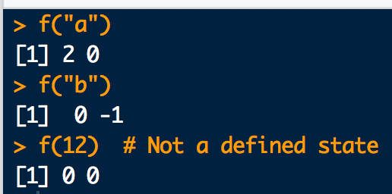
Here is how you can implement feature functions in R:
# Make up some state labels:
s1 <- "a"
s2 <- "b"
# Define a weight vector:
w <- c(2,-1)
# Define feature function:
f <- function(y){ w * as.numeric(c((y==s1),(y==s2))) }
# Try it out:
f("a")
f("b")
# What happens for an undefined state?
f(12)
scr1.R

Slide 16
There is also CRFutil2 built-in feature functions for convenience:
ff0.R
ff0_C.cpp
ff1_C.cpp
ff2_C.cpp
library(CRFutil2)
# Make up some state labels:
s1 <- "a"
s2 <- "b"
# Define a weight vector:
w <- c(2,-1)
# A feature function built into CRFutil2:
ff0(st = "b", ss.dim = 2, w.vec = w, st.vec = c(s1,s2))
scr2.R

Slide 17
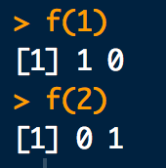
We usually define the feature function this way to work with CRF output:
# State labels used by CRF:
s1 <- 1
s2 <- 2
# Define feature function. State weights are implicitly 1:
f <- function(y){ as.numeric(c((y==s1),(y==s2))) }
# Try it out:
f(1)
f(2)
scr3.R
Compare with example two-slides ago

Slide 18
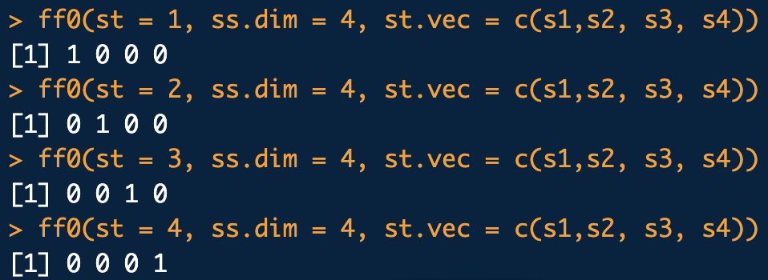
Feature function for a Potts-like model is the same idea:
library(CRFutil2)
# Define 4 state labels for a Potts-like model:
s1 <- 1
s2 <- 2
s3 <- 3
s4 <- 4
# Try it out:
ff0(st = 1, ss.dim = 4, st.vec = c(s1, s2, s3, s4))
ff0(st = 2, ss.dim = 4, st.vec = c(s1, s2, s3, s4))
ff0(st = 3, ss.dim = 4, st.vec = c(s1, s2, s3, s4))
ff0(st = 4, ss.dim = 4, st.vec = c(s1, s2, s3, s4))
scr4.R

Slide 19
Using feature functions, we can write node and edge energies in convenient matrix-vector form(s):
node energies
is called the node i weight vector:
If w = id(m) (all ones vector) then has entries numerically equivalent to node i energies

Slide 20
Using feature functions*, we can write node and edge energies in convenient matrix-vector form(s):
edge energies
is called the edge ij weight matrix:
The node state spaces of each node need not be the same:
Rectangular if number of node states for node i is not the same as node j (m≠n)
Square if number of node states for node i is the same as node j (m=n)
If w for each node state space is 1 then has entries numerically equivalent to edge ij energies
*Feature functions play a role similar to spin-orbital one-body basis functions familiar from many-body theory.

Slide 21
A concrete illustration of this notation for models considered with only 2 states at each node (i.e. Ising-like) and each state having weight 1 is:
Thus, the node and edge weights are:
The corresponding node and edge energies in table form are:

Slide 22
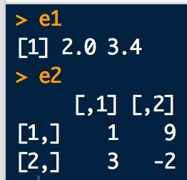
Here is how one and two-body energy calculations can be implemented in R:
library(CRFutil2)
# Consider an Ising-like model with:
tau <- c(2, 3.4) # node weights
omega <- rbind( # edge weights
c(1,9),
c(3,-2)
)
# one-body energies:
e1 <- c(ff0(1) %*% tau , ff0(2) %*% tau)
e1
# two-body energies
e2 <- rbind(
c(ff0(1) %*% omega %*% ff0(1), ff0(1) %*% omega %*% ff0(2)),
c(ff0(2) %*% omega %*% ff0(1), ff0(2) %*% omega %*% ff0(2))
)
e2
scr5.R

Slide 23
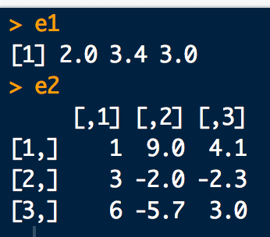
For a Potts-like model things are pretty similar:
#Consider an Potts-like model with node/edge weights:
tau <- c(2, 3.4, 3)
omega <- rbind(
c(1, 9, 4.1),
c(3, -2, -2.3),
c(6, -5.7, 3 )
)
# Define states and feature function:
s1 <- 1
s2 <- 2
s3 <- 3
# one-body energies:
e1 <- c(ff0(1, ss.dim = 3) %*% tau, ff0(2, ss.dim = 3) %*% tau, ff0(3, ss.dim = 3) %*% tau)
e1
# two body energies
e2 <- rbind(
c(ff0(1,3) %*% omega %*% ff0(1,3), ff0(1,3) %*% omega %*% ff0(2,3), ff0(1,3) %*% omega %*% ff0(3,3)),
c(ff0(2,3) %*% omega %*% ff0(1,3), ff0(2,3) %*% omega %*% ff0(2,3), ff0(2,3) %*% omega %*% ff0(3,3)),
c(ff0(3,3) %*% omega %*% ff0(1,3), ff0(3,3) %*% omega %*% ff0(2,3), ff0(3,3) %*% omega %*% ff0(3,3))
)
e2
scr6.R

Slide 24
Finally, the node and edge potentials are:
With these components we can write the full joint probability distribution as:

Slide 25
Going a tad further with the notation:
If you want to explicitly include the β parameter
Note, this is the same for Ising and Potts-like models.

Slide 26
The term in the exponential is the configuration “energy” E(X)
The sums are not actually sums over vectors/matrices. Rather they are sums of individual one and two-body components of energy corresponding to the states of variables in X.
To make the above formula more explicit:
Double sum over i, j
Node i connected to node j
i < j is implicit
In physics is called a Hamiltonian

Slide 27
Example 1: Compute the E(X) for all node state configurations
B
A
C

Slide 28
For this graph, the energy function is:
one-body energy
two-body energy

Slide 29
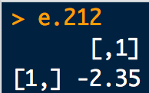
Example 1: Triangle
# node weights:
tauA <- c( 1, -1.3)
tauB <- c(-0.85, -2.4)
tauC <- c(3.82, 1.4)
# edge weights:
omegaAB <- rbind(
c( 3.5, -1.4),
c(-1.4, 2.5)
)
omegaBC <- rbind(
c( 2.6, 0.4),
c( 0.4, 2.5)
)
omegaAC <- rbind(
c(-0.6, 1.2),
c( 1.2, -0.6)
)
# Define states and feature function:
s1 <- 1
s2 <- 2
# Enumerate all the state configurations
config.mat <- expand.grid(c(s1,s2),c(s1,s2),c(s1,s2))
colnames(config.mat) <- c("A","B","C")
config.mat
# Energy(A=2,B=1,C=2)
e1.212 <- ff0(2)%*%tauA + ff0(1)%*%tauB + ff0(2)%*%tauC
e2.212 <- ff0(2)%*%omegaAB%*%ff0(1) + ff0(1)%*%omegaBC%*%ff0(2) + ff0(2)%*%omegaAC%*%ff0(2)
e.212 <- e1.212 + e2.212
e.212
scr7.R

Slide 30
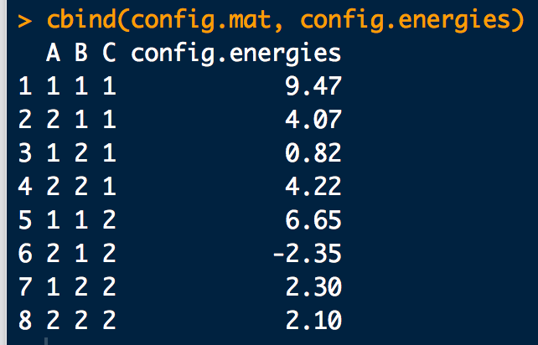
Example 1: Triangle (con’t)
# To cut down on the amount of work we have to do, use CRFutil2:
library(CRFutil2)
# Define the edge connectivity matrix
edges <- rbind(
c(1,2), #AB
c(1,3), #AC
c(2,3) #BC
)
# Test: CRFutil2 function to compute a configuration energy.
config.energy(config = c(2,1,2),
edges.mat = edges,
one.lgp = list(tauA,tauB,tauC),
two.lgp = list(omegaAB,omegaAC,omegaBC), # use same order as edges!
ff = f)
# Define a convenience function wrapper:
ener.func <- function(config) {
engy <-config.energy(
config = config,
edges.mat = edges,
one.lgp = list(tauA,tauB,tauC),
two.lgp = list(omegaAB,omegaAC,omegaBC),
ff = f)
return(engy)
}
# Test:
ener.func(c(2,1,2))
# Use to compute all configuration energies:
config.energies <- sapply(1:nrow(config.mat), function(xx){ener.func(config.mat[xx,])})
cbind(config.mat, config.energies)
scr8.R

Slide 31
A short hand, but explicitly parameterized way to write the probability distribution is thus:
In physics this is usually called a Boltzmann distribution*. In statistics and machine learning it is usually referred to as a Gibbs distribution
Since E(X) (or E’(X)) only contains up to two-body terms, this is also called a pair-wise Markov random field.
In order to really be able to use Pr(X), we need to know the partition function Z.
The un-normalized part is a product of potential terms (prodPot**) and is often written as:
**In physics, prodPots are called Boltzmann weights and Boltzmann factors

Slide 32
Sum all prodPots
Z normalizes the probability distribution and is generally referred to as a partition function*.
Z is really hard to get in general because we have to sum over all configurations X. This gets large quickly with increasing number of nodes and increasing number of node-states.
For an Ising-like model with 20 variables there are 2²⁰ = 1048576 explicit terms in Z.
For a Potts-like model with 16 variables and 256 states per node (like a simple 4×4 8-bit image) there are 256¹⁶ = 3.402824… × 10³⁸ explicit terms in Z.
Luckily, if the potentials are known or can be fit, there are various approaches that take advantage the graph structure for Pr(X) which can often be used to exactly or approximately compute Z.
*the name comes from statistical physics

Slide 33
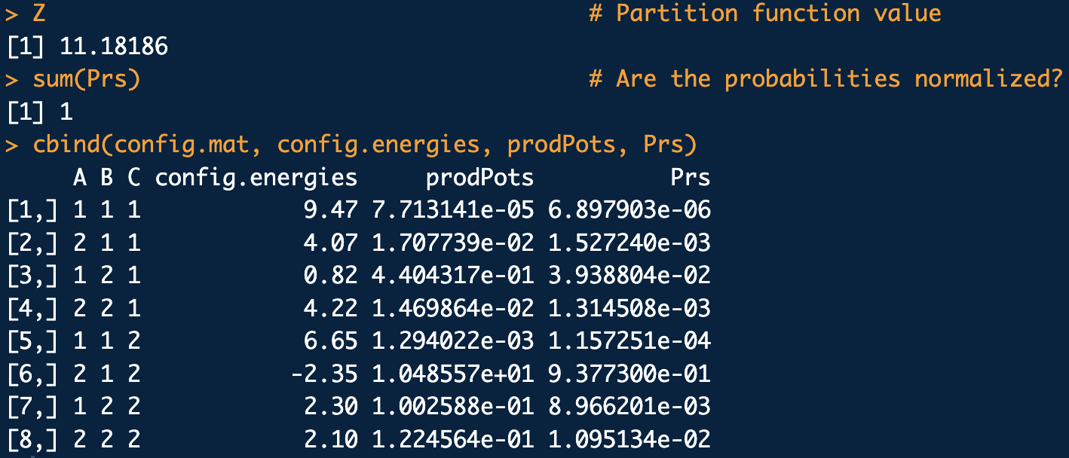
Example 1: Triangle (con’t)
# All configuration energies:
config.energies <- sapply(1:nrow(config.mat), function(xx){ener.func(config.mat[xx,])})
prodPots <- exp(-config.energies) # Product Potentials
Z <- sum(prodPots) # The Partition function (by brute force...)
Prs <- prodPots/Z # Configuration probabilities
Z
sum(Prs)
cbind(config.mat, config.energies, prodPots, Prs)
scr8.R
B
A
C
Minor note: The highest prob configs will correspond to the lowest energy. Same deal in physics where its usually called the ground state.

Slide 34

Example 2: Schmidt Small
https://www.cs.ubc.ca/~schmidtm/Software/UGM/small.html
library(CRFutil2)
#The potentials for Cathy-Heather-Mark-Allison: 1-2-3-4
Psi1 <- c(0.25, 0.75)*4
Psi2 <- c(0.9, 0.1) *10
Psi3 <- c(0.25, 0.75)*4
Psi4 <- c(0.9, 0.1) *10
Psi12 <-
6*rbind(c(2/6, 1/6),
c(1/6, 2/6))
Psi23 <-
6*rbind(c(2/6, 1/6),
c(1/6, 2/6))
Psi34 <-
6*rbind(c(2/6, 1/6),
c(1/6, 2/6))
# Define states and feature function:
s1 <- "right"
s2 <- "wrong"
# Enumerate all the state configurations
config.mat <- expand.grid(c(s1,s2),c(s1,s2),c(s1,s2),c(s1,s2))
colnames(config.mat) <- c("Cathy", "Heather", "Mark", "Alison")
scr9.R

Slide 35
Example 2: Schmidt Small (con’t)
https://www.cs.ubc.ca/~schmidtm/Software/UGM/small.html
# Edge connectivity matrix
edges <- rbind(
c(1,2), # Cathy-Heather
c(2,3), # Heather-Mark
c(3,4) # Mark-Allison
)
# Define a convenience function wrapper:
ener.func <- function(config) {
engy <-config.energy(config = config, edges.mat = edges,
one.nlp = list(-log(Psi1),-log(Psi2),-log(Psi3),-log(Psi4)),
two.nlp = list(-log(Psi12),-log(Psi23),-log(Psi34)),
ff = ff1,
nss.vec = c(s1,s2))
return(engy)
}
# All configuration energies:
config.energies <- sapply(1:nrow(config.mat), function(xx){ener.func(config.mat[xx,])})
prodPots <- exp(config.energies)
Z <- sum(prodPots)
Prs <-prodPots/Z
Z
sum(Prs)
cbind(config.mat, config.energies, prodPots, Prs)
scr9.R

Slide 36
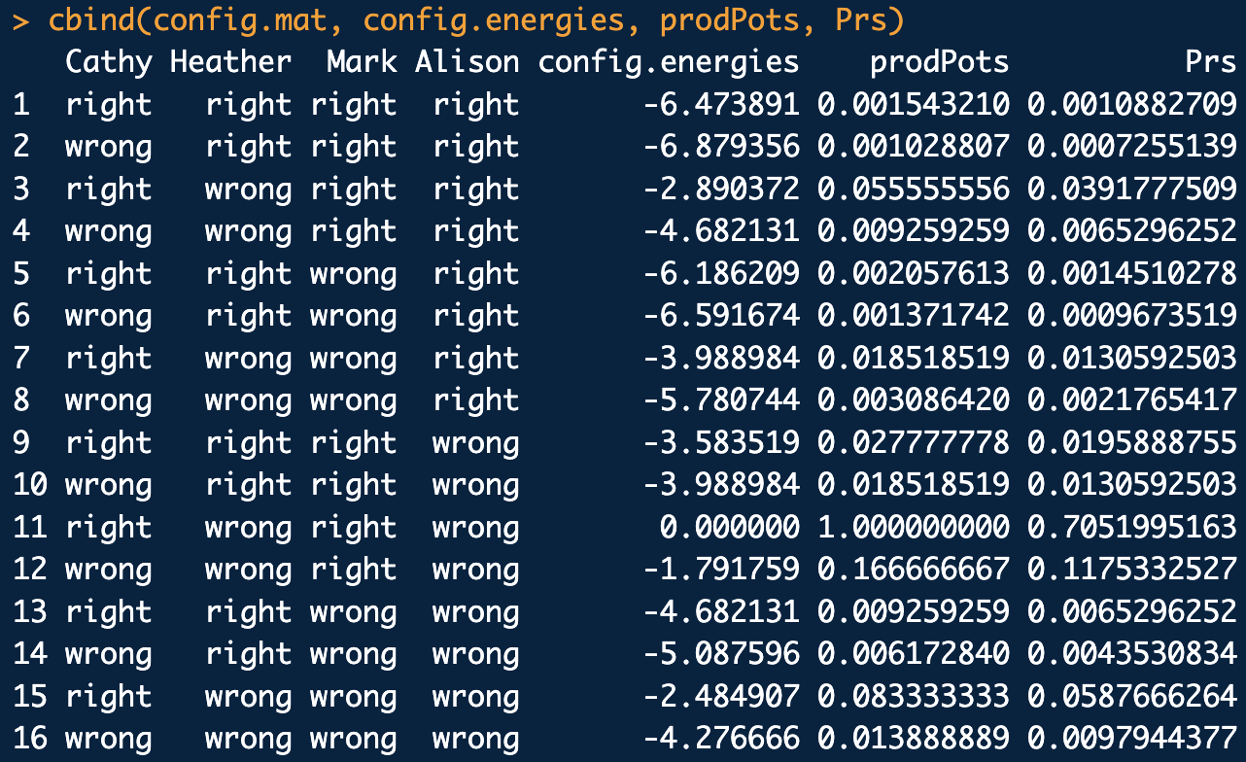
Example 2: Schmidt Small (con’t)
https://www.cs.ubc.ca/~schmidtm/Software/UGM/small.html

Slide 37
Example 3: Star field, more elaborate example.
A
This time we’ll assign potentials randomly and use CRFutil convenience functions:
E
B
D
C
library(CRFutil2)
# Graph formula for Star field:
grphf <- ~A:B+A:C+A:D+A:E+B:C+B:D+B:E+C:D+D:E
adj <- ug(grphf, result = "matrix")
# Define node state space and configuration space:
#s1 <- "up"; s2 <- "dn"
s1 <- 1; s2 <- 2
star <- make.empty.field(graph.eq = grphf,
num.states = 2,
state.names = rep(list(c(s1,s2)), nrow(adj)),
parameterization.typ = "standard",
plotQ = T)
# Make up some random parameters and insert them into the model:
set.seed(1)
star.rthetas <- rnorm(n = star$num.par, mean = 0, sd = 1)
insert.params.and.pots(star, params.samp = star.rthetas)
dump.crf(star)
scr10.R

Slide 38
Example 3: Star field, more elaborate example. (con’t)
# NEW: Compute Probs of all configurations and logZ from energies:
dist.en.info <- distribution.from.energies(star)
# NEW: As a check compute Probs of all configurations and logZ from potentials as well:
# First decorate potentials and energies with gRbase annotations to use with gRbase
# functionality:
make.gRbase.potentials(crf=star)
dist.pot.info <- distribution.from.potentials(star)
# Check that we get the same configuration probs:
Pr.en <- dist.en.info$config.probs$prob
Pr.pot <- dist.pot.info$config.probs$prob
Pr.en-Pr.pot # Should all be 0 or close to it.
# Config probs by hand with configuration energies:
X <- expand.grid(star$node.state.names) # All configurations
X <- order.configs(X, star, order.nodesQ = T)$config.mat # Put in canonical order
E.X <- sapply(1:nrow(X), function(xx){energye(X[xx,], star)}) # Compute config energies
prodPots.X <- exp(-E.X)
Z <- sum(prodPots.X)
Pr.X <- 1/Z*prodPots.X
# Put results in a nice table:
data.frame(X,E.X,prodPots.X,Pr.en,Pr.pot,Pr.X)
scr10.R

Slide 39
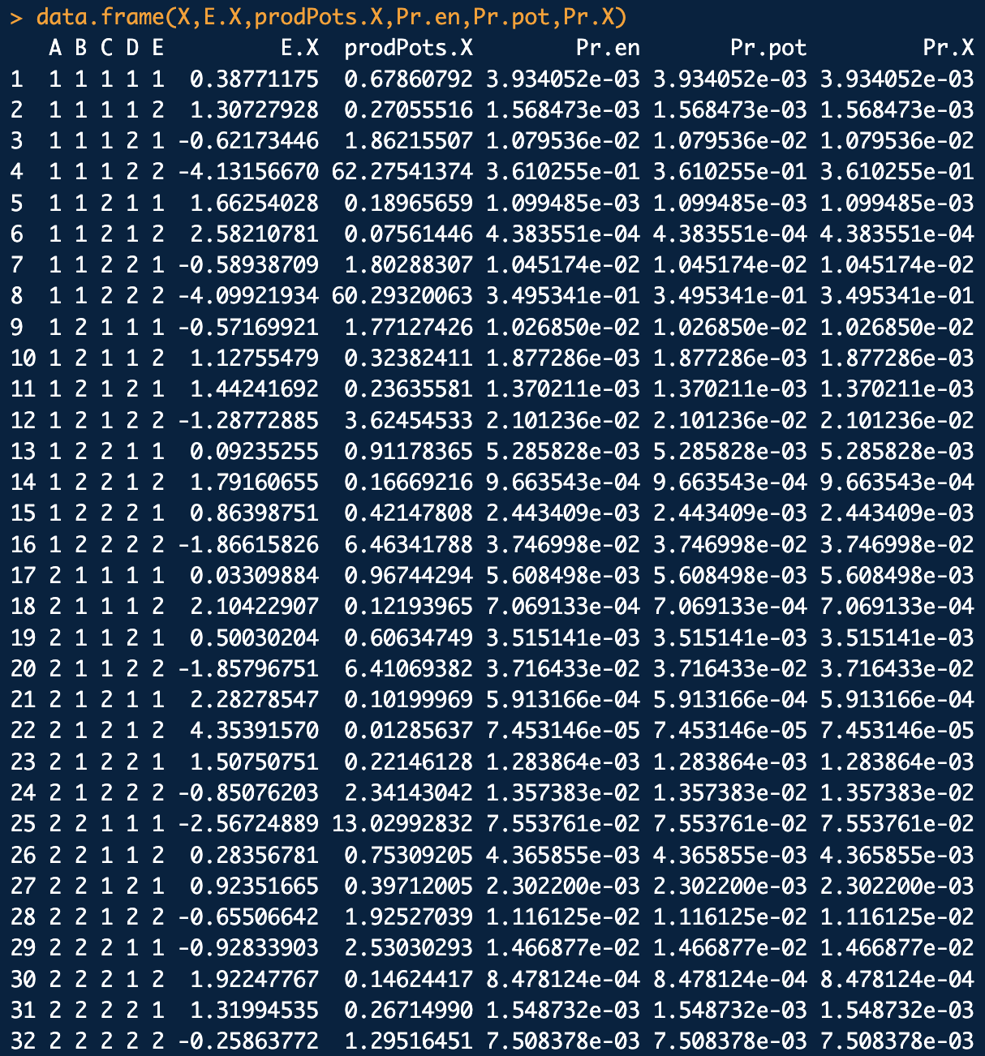
Example: Star field, more elaborate example. (con’t)

Slide 40
Example 4: Triangle Potts: a (random potential) Potts-like model in the standard parameterization with three node states per node:
library(CRFutil2)
grphf <- ~A:B + B:C + C:A
adj <- ug(grphf, result = "matrix")
tri <- make.empty.field(graph.eq = grphf, num.states = 3, parameterization.typ="standard", plotQ=T)
# Make up some random parameters and insert them into the model:
set.seed(1)
tri.rthetas <- rnorm(n = tri$num.par, mean = 0, sd = 1)
insert.params.and.pots(tri, params.samp = tri.rthetas)
dump.crf(tri)
# Define node state space and configuration space:
config.mat <- expand.grid(tri$node.state.names) # All configurations
config.mat <- order.configs(config.mat, tri, order.nodesQ = T)$config.mat # Put in canonical order
# Compute energies of all configs:
config.energies <- sapply(1:nrow(config.mat), function(xx){energye(config.mat[xx,], tri)})
# Compute configuration probabilities:
prodPots <- exp(-config.energies) # Product Potentials
Z <- sum(prodPots) # The Partition function (by brute force...)
Prs <-prodPots/Z # Configuration probabilities
Z # Partition function value
sum(Prs) # Are the probabilities normalized?
cbind(config.mat, config.energies, prodPots, Prs) # Put results in a nice table
plot(1:nrow(config.mat), Prs, typ="h", xlab="X config #", ylab="Pr(X)", main="Configuration Probabilities")
scr11.R

Slide 41
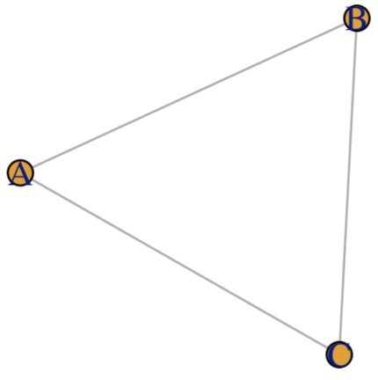
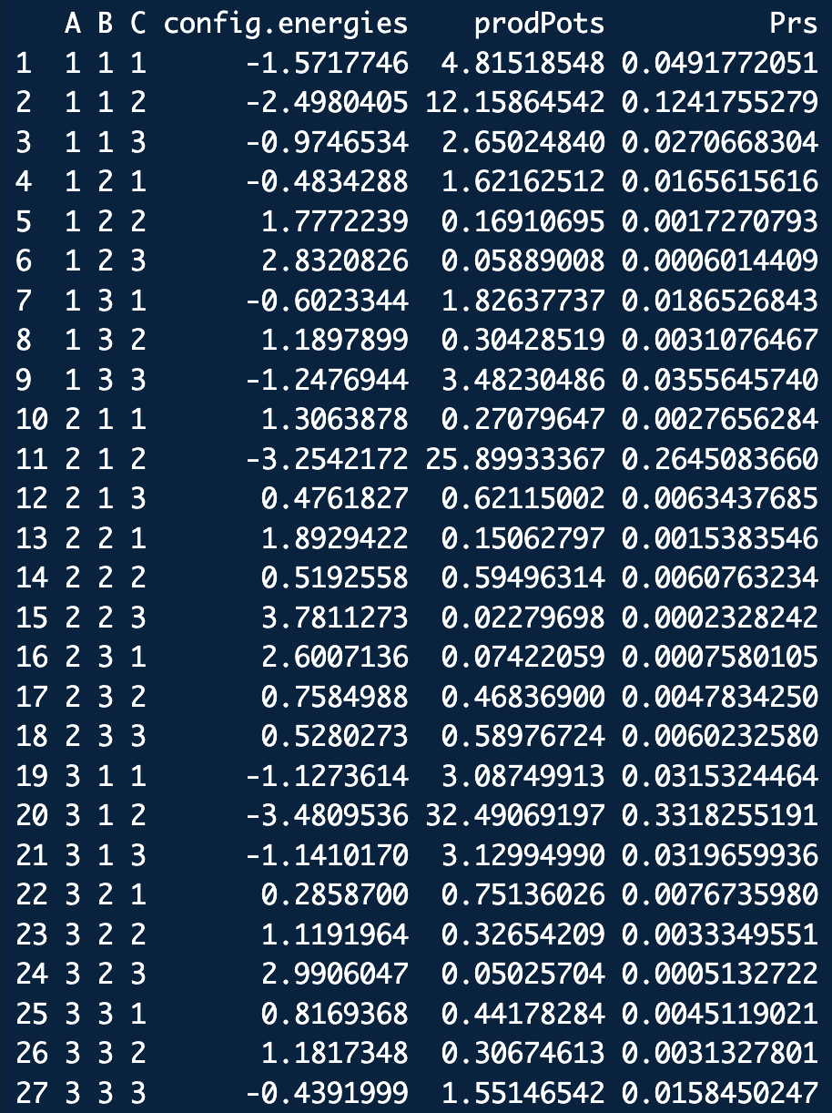
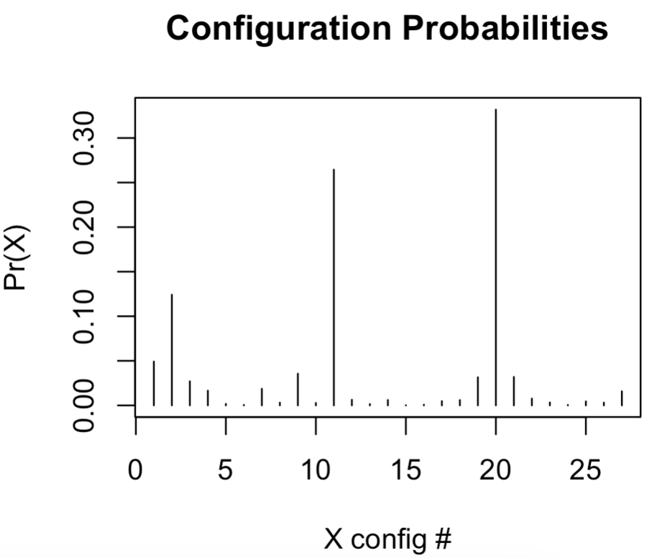
Example 4: Triangle Potts. (con’t)

Slide 42
Example 5: A bigger, variable node state Potts-like model:
library(CRFutil2)
# Graph formula for Star field:
grphf <- ~A:B+B:C+C:D+D:A+D:B+C:E
adj <- ug(grphf, result = "matrix")
# Define node state space and configuration space (weird on purpose):
sA1 <- "A1"; sA2 <- "A2"
sB1 <- "B1"; sB2 <- "B2"; sB3 <- "B3"
sC1 <- 1; sC2 <- 2
sD1 <- "D1"; sD2 <- "D2"; sD3 <- "D3"; sD4 <- "D4"
sE1 <- 1; sE2 <- 3; sE3 <- 2
wp <- make.empty.field(graph.eq = grphf,
num.states = c(2,3,2,4,3),
state.names = list(c(sA1,sA2),
c(sB1,sB2,sB3),
c(sC1,sC2),
c(sD1,sD2,sD3,sD4),
c(sE1,sE2,sE3)),
parameterization.typ = "standard",
plotQ = T)
dump.crf(wp)
# Make up some random parameters and insert them into the model:
set.seed(1)
wp.rthetas <- rnorm(n = wp$num.par, mean = 0, sd = 1)
wp.rthetas
length(wp.rthetas)
insert.params.and.pots(wp, params.samp = wp.rthetas)
# Decorate potentials and energies with gRbase annotations to use later:
make.gRbase.potentials(crf=wp, includeQ = T)
dump.crf(wp)
# Get a sample of configs:
wp.samp <- sample.crf(crf = wp, size = 1000, crf.sample.method = sample.junction, dress.sampleQ = T, data.frameQ=T)
plot.marginal.sample(wp.samp, wp)
plot.configuration.sample(wp.samp, crf = wp, num.top.configs = 3)
scr12.R

Slide 43
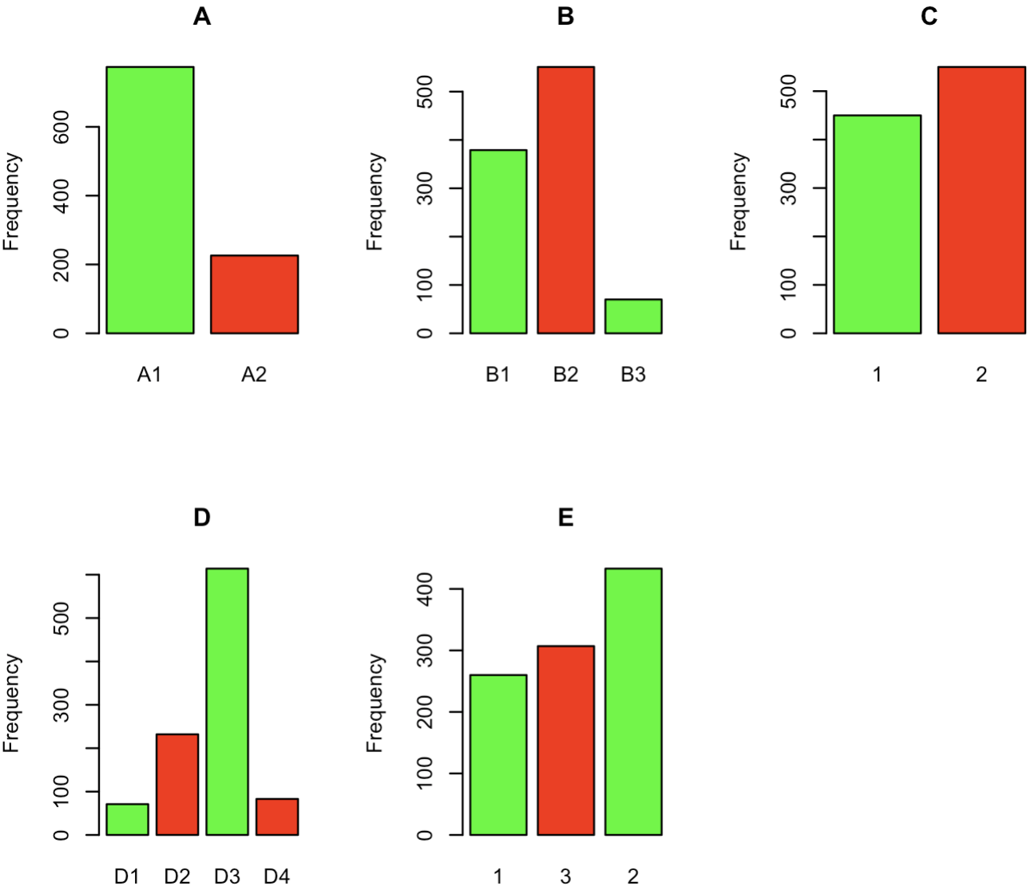
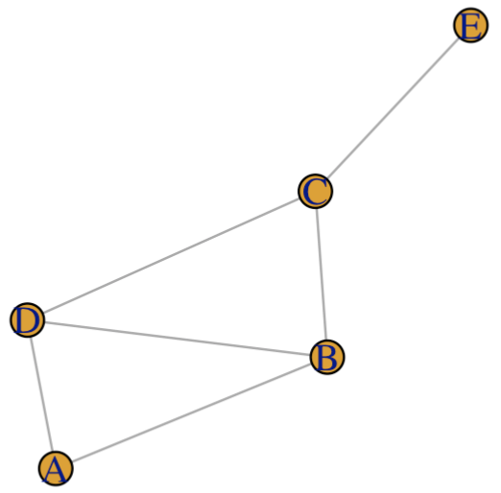
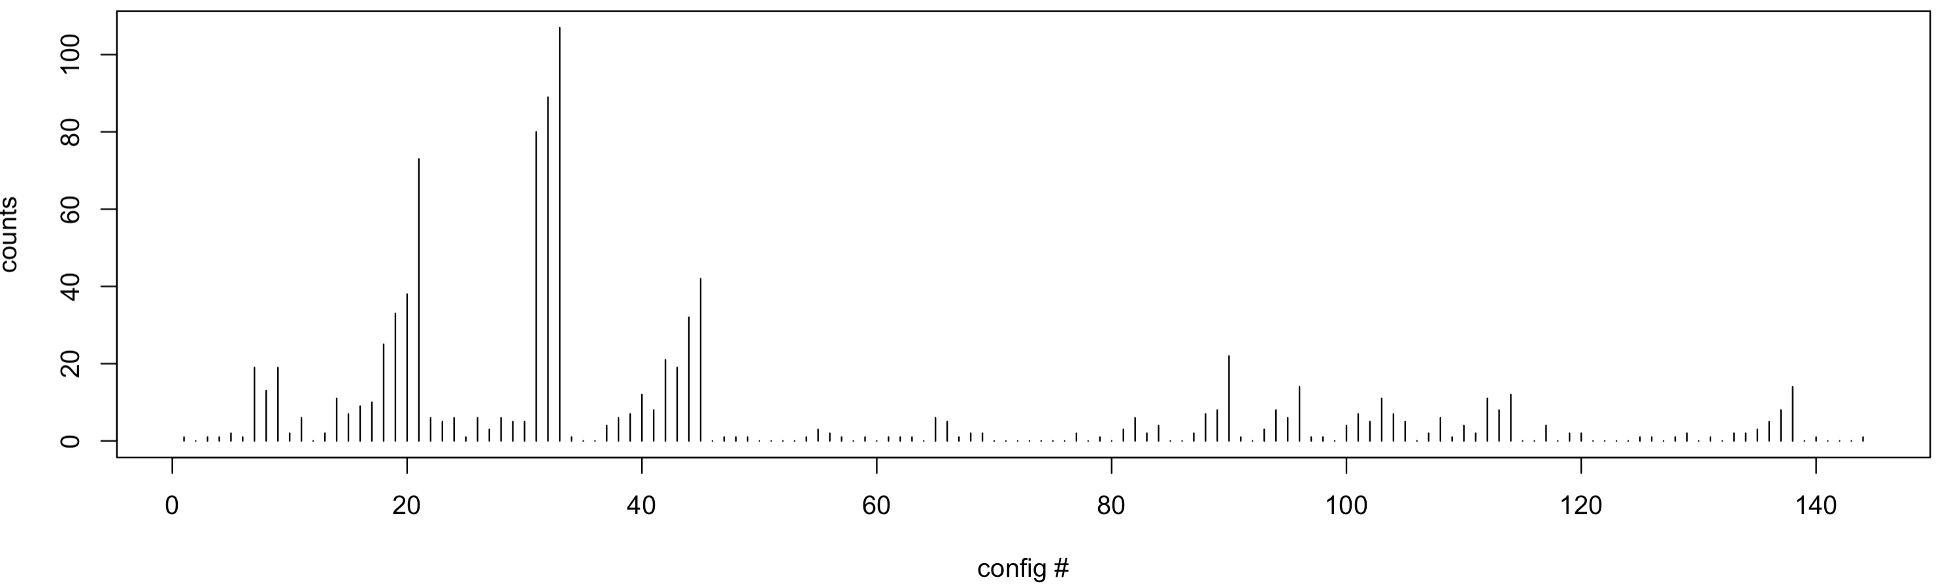
Example 5: A bigger, variable node state Potts-like model (con’t):

Slide 44
Some Notes About Parameterization
So, for this work, the major problem is determining the potentials
Parameterization of the potentials is fairly arbitrary:
Scalar multiplication is associative over the algebra of potentials so they can always be re-scaled to reduce the number of parameters, e.g. for an Ising-like model:
The symbol ∘ is multiplication between potentials

Slide 45
Some Notes About Parameterization
For a four state Potts-like model this exercise could look like:

Slide 46
Some Notes About Parameterization
A model where the node state space varies from node to node, could look like:
This is an example of the general parameterization.

Slide 47
Some Notes About Parameterization
We will usually choose the standard parameterization:
choose reference node and edge elements to eliminate parameter redundancy
transposed edge elements are equal
diagonal edge elements are equal
So for node parameters in the standard parameterization, taking the n^{th} (last) element to be the “reference” element:

Slide 48
Some Notes About Parameterization
For a general m×n edge parameter matrix in the standard parameterization:
square symmetric matrix part
diagonal elems. equal
rectangular part with m > n
take as reference bottom left element of symmetric matrix
re-scaled symmetric matrix, 0s in lower left and upper right corners
rectangular part with m < n
rectangular part, just indexed sequentially
Same deal for flexible parameterization scheme except diagonal elements need not be equal.
diagonal elems. equal

Slide 49
Some Notes About Parameterization
So, in the standard parameterization the edge matrices in general are:
for m > n
for m < n

Slide 50
Some Notes About Parameterization
In the slightly more flexible parameterization for we allow the freedom for the diagonal elements of the edge matrices to not be equal:
for m > n
for m < n
Node parameters in the flexible parameterization are the same as in the standard parameterization.

Slide 51
Some Notes About Parameterization
The standard parameterization for an Ising-like model then looks like:
For node parameters:
For edge parameters:
In the flexible parameterization, for where we allow the freedom for ω_{ij11} ≠ ω_{ij22}:
Note again the τ_{i} and ω_{ij} are determined relative to the 0-terms

Slide 52
Some Notes About Parameterization
Another popular parameterization is actual Ising parameterization, but it’s equivalent to the standard parameterization:
For node parameters in the Ising parameterization:
For edge parameters in the Ising parameterization:
If all the node parameters are the same and all the edge parameters are the same, we recover Ising’s original parameterization from statistical mechanics:

Slide 53
Some Notes About Parameterization
A concrete example of a Potts-like model in the standard parameterization looks like:
In the flexible parameterization, for where we allow the freedom for ω_{ij11} ≠ ω_{ij22} ≠ ω_{ij33}:

Slide 54
Some Notes About Parameterization
In summary, using a two node Ising-like model as a reference, under these parameterizations Pr(X) can be:
general parameterization
standard parameterization
flexible parameterization
∘ is multiplication between potentials

Slide 55
Some Notes About Parameterization
In summary, using a two node Potts-like model as a reference, under these parameterizations Pr(X) can be:
general parameterization
standard parameterization
flexible parameterization

Slide 56
Some Notes About Parameterization
In summary, using a two node Potts-like model with unequal node state space dimensions as a reference, Pr(X) can be:
general parameterization
standard parameterization
flexible parameterization

Slide 57
MRF Likelihood and the Feature Formulation
To estimate parameters given data, the standard of practice is to find the Maximum Likelihood Estimate (MLE) or Maximum Pseudo-Likelihood Estimate (MPL).
As an example of an MRF likelihood consider the triangle model in the standard parameterization:
B
A
C

Slide 58
For this model (as every other MRF):
The log-likelihood for a configuration X is proportional to:
The total log-likelihood for a sample of data of size N (i.e. N X_{i}) is:
or

Slide 59
Let's say we observe the sample:
X₁ = (1,1,1)
X₂ = (1,2,1)
X₃ = (1,1,1)
The energies of each sampled configuration are:
Thus, the total sample log-likelihood is:

Slide 60

Thus, the total sample log-likelihood is:
MRF sufficient statistics: the number of times each parameter appears in the total log-likelihood
Having a sample of size N and a parameterized MRF model, one can always compute the corresponding vector of sufficient statistics s
for this model and sample
Collecting together the parameters of the MRF into a vector
for this model
we can represent the total log-likelihood as:

Slide 61
A note about the sufficient statistics s:
Let φ_{k}(X) = φ_{k} be the number of times parameter k appears in E(X)
φ_{k} are indicator variables: φ_{k} = 1 if parameter k appears in E(X) and 0 otherwise.
φ_{k} is called a “feature” (just to be confusing…). It is not the feature function f(X_{i}), but is related to it (see next slide).
As an example consider X₂ for the triangle network:
with
φ₁(X₂) = φ_{τA}(X₂) = 1
φ₂(X₂) = φ_{τB}(X₂) =0
φ₃(X₂) = φ_{τC}(X₂) =1
φ₄(X₂) = φ_{ωAB}(X₂) =0
φ₅(X₂) = φ_{ωAC}(X₂) =1
φ₆(X₂) = φ_{ωBC}(X₂) =0

Slide 62
Thus, for node parameters τ:
A little extra notation to indicate node i is associated with parameter k. Though i and k are often the same number, they can differ depending on the parameterization scheme.
For edge parameters ω:
A little extra notation for edges to show what nodes are associated with parameter k

Slide 63
SAY AND ILLUSTRATE SOMETHING INTUITIVE ABOUT WHAT A PHI FEATURE VECTOR FOR A CONFIGURATION MEANS
LIKE: phi shows which parameters make a non zero contribution to the energy of configuration X

Slide 64
Aside: Parameter Index Matrices
It’s a bit confusing (for me at least…) to convert between parameter and node/edge indices.
The “easiest” way I can think of is to exploit the UGM/CRF data structures which must be set up to index the parameterization scheme chosen. They are the parameter index matrices
In UGM these are called nodeMap and edgeMap
In CRF these are called node.par and edge.par

Slide 65
Aside: Parameter Index Matrices
We’ll stick with the CRF nomenclature for these things.
Let’s consider an example (weird) parameterization of the triangle model:
X₂
X₁
X₃

Slide 66
Aside: Parameter Index Matrices
node.par (η_{τ}) is a row-stacked matrix of tau-index vectors:
s_{Xi}= ⬆ ⬇
X₁
X₂
X₃
edge.par (ε_{ω}) is an (R) list of omega-index matrices:
X₂:
X₃:
X₃:
⬆ ⬇
⬆ ⬇
⬆ ⬇
X₁:
⬆
⬇
X₁:
⬆
⬇
X₂:
⬆
⬇

Slide 67
Aside: Parameter Index Matrices
Using these parameter index matrices, it is a little more transparent as to how the conversion between parameter and node/edge indices works (dropping the φ and just writing k for simplicity instead of φ_{k}):
parameter k node i in state X_{i} = s_{Xi}
row i of η_{τ} matrix
parameter k node i in state X_{i} = s_{Xi}
node j in state X_{j}= s_{Xj}
We’ll find this handy later.

Slide 68
Aside: Parameter Index Matrices
For example, under this model/parameterization consider configuration X = (1,2,1):

Slide 69
Aside: Parameter Index Matrices
For example, under this model/parameterization and configuration X = (1,2,1):
From these evaluation we can infer the configuration’s vector of features:

Slide 70
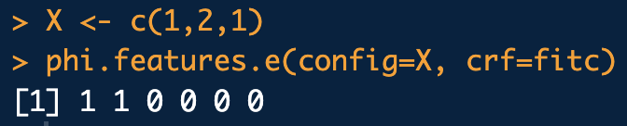
Aside: Parameter Index Matrices
Check:
library(CRFutil2)
# Graph formula:
grphf <- ~A:B:C
adj <- ug(grphf, result="matrix")
s1 <- 1; s2 <- 2
# (Admittedly weird) Parameterization:
np <- array(0, c(3,2,1))
np[1,1,] <- 1
np[2,1,] <- 2
np[3,1,] <- 2
epm <- array(0, c(2,2,1))
ep <- list(epm,epm,epm)
ep[[1]][1,1,1] <- 3
ep[[1]][2,2,1] <- 3
ep[[2]][1,1,1] <- 2
ep[[2]][2,2,1] <- 4
ep[[3]][1,1,1] <- 5
ep[[3]][2,2,1] <- 6
fitc <- make.empty.field(graph.eq = grphf,
num.states = 2,
state.names = list(c(s1,s2),c(s1,s2),c(s1,s2)),
parameterization.typ = "custom",
node.par = np,
edge.par = ep,
plotQ = T)
dump.crf(fitc)
X <- c(1,2,1)
phi.features.e(config=X, crf=fitc) #NOTE: config node states must be state indices!
scr13.R

Slide 71

Arranging a vector of of φ_{k}’s in rows, one-row for each configuration X, gives a “model matrix” for an MRF with w total parameters and N realized configurations:
θ₁
θ₂
θ_{w}
X₁
X₂
X_{N}
Summing down the columns of M gives the sufficient statistics s:

Slide 72
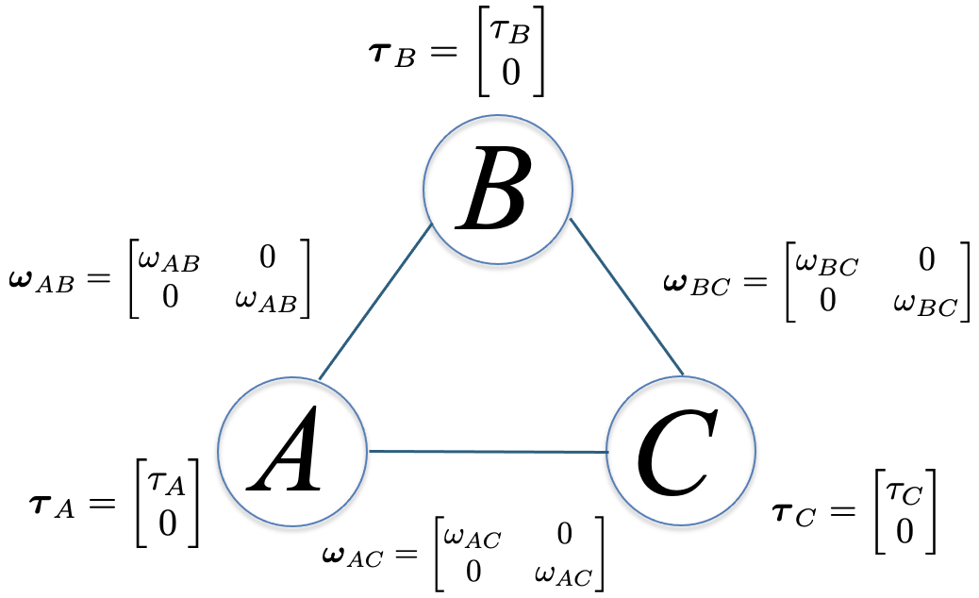
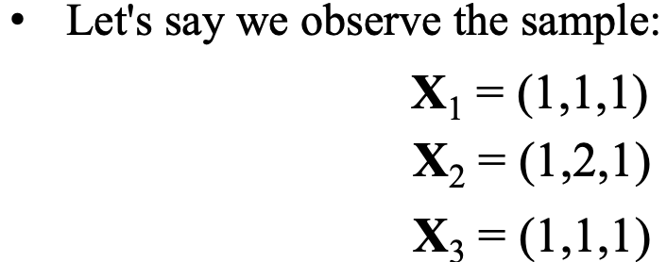
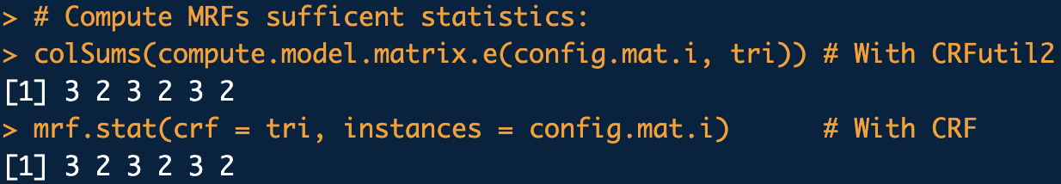
Check this for triangle model in the standard parameterization:
library(CRFutil2)
# Graph formula for simple two node field:
grph <- ~A:B+A:C+B:C
# Define node state space:
s1 <- "up"; s2 <- "dn"
tri <- make.empty.field(
graph.eq = grph,
num.states = 2,
state.names = rep(list(c(s1,s2)), 3),
parameterization.typ = "standard",
plotQ = T)
dump.crf(tri)
config.mat <- rbind(
c(s1,s1,s1),
c(s1,s2,s1),
c(s1,s1,s1)
)
config.mat.i <- configs.n2i(config.mat, crf = tri)
# Compute MRFs sufficent statistics:
colSums(compute.model.matrix.e(config.mat.i, tri)) # With CRFutil2
mrf.stat(crf = tri, instances = config.mat.i) # With CRF
scrmmss.R

Slide 73
Next, using “features” we can express the probability of a configuration X equivalently as:
Note the correspondence:
“energy” contribution per parameter to configuration X
feature formulation
feature function formulation
Feature formulation of configuration energy shows energy contributions from each parameter
Feature function formulation of configuration energy shows energy as a sum of node (i.e. base-level) and edge (i.e. interaction) contributions

Slide 74
Example:
a. Check the equivalence for a Star field: Show for each possible outcome for X (i.e. all possible configurations) the energies computed are the same:
vs.
library(CRFutil2)
# Graph formula for simple two node field:
grph <- ~A:B+A:C+A:D+A:E+B:C+B:D+B:E+C:D+D:E
# Define node state space:
s1 <- "up"; s2 <- "dn"
star <- make.empty.field(graph.eq = grph,
num.states = 2,
state.names = rep(list(c(s1,s2)), 5),
parameterization.typ = "standard",
plotQ = T)
# Make up some random parameters and insert them into the model:
set.seed(1)
star.rthetas <- rnorm(n = star$num.par, mean = 0, sd = 1)
insert.params.and.pots(star, params.samp = star.rthetas)
dump.crf(star)
scr14.R

Slide 75
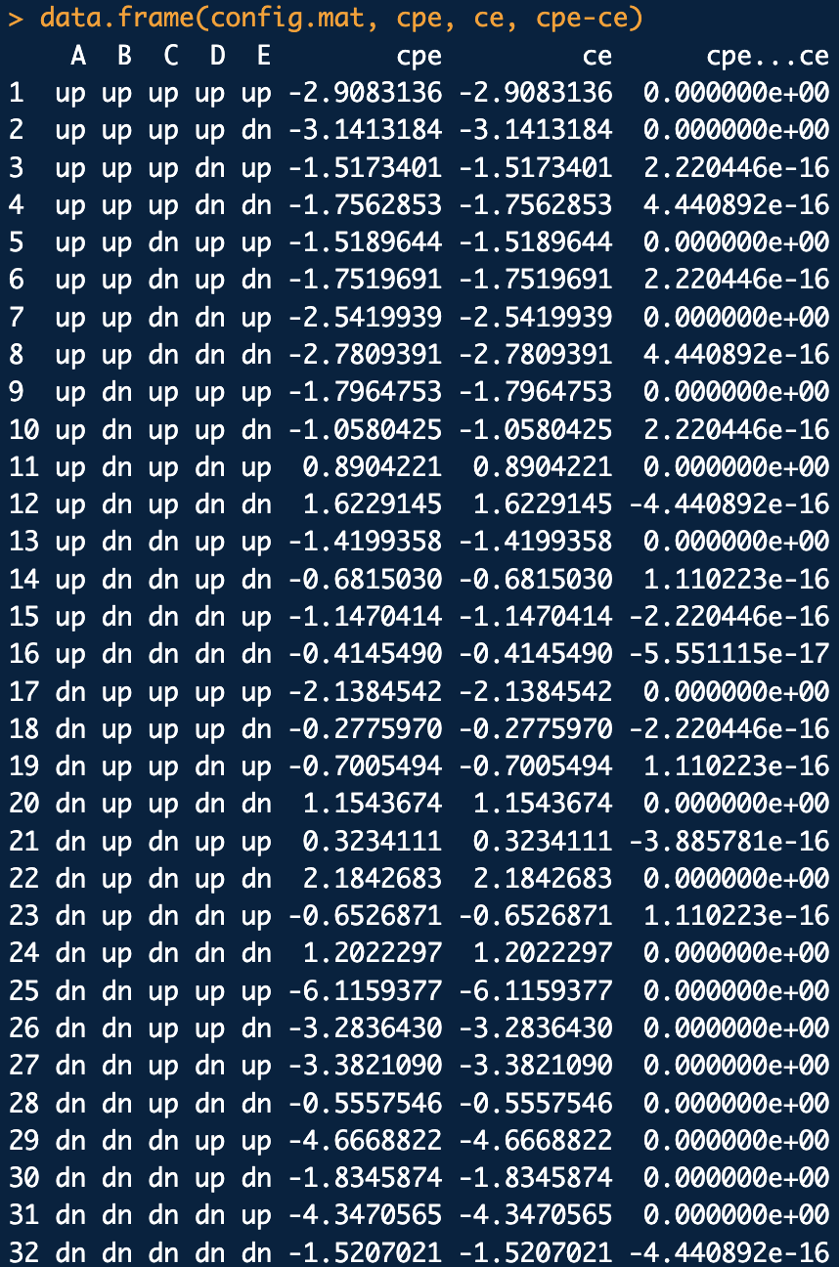
# Generate and order all configurations in node state index form:
config.mat <- order.configs(configs.mat=expand.grid(star$node.state.names),
crf = star, st.idxQ=T, order.nodesQ=T)$config.mat
config.mat.i <- configs.n2i(config.mat, crf = star)
# E({\bf X}) = {\boldsymbol \theta}^{\dagger} {\boldsymbol \phi}({\bf X})
cpe <- sapply(1:nrow(config.mat.i), function(xx){energyphe(config.mat.i[xx,], star)})
# E({\bf X}) =\sum_{i=1}^{\#\text{nodes}}{\bf f}^{\dagger}(X_i=s_{X_i}) {\boldsymbol \tau}_{i}
# + \sum_{i\sim j}^{\# \text{edges}}
# {\bf f}^{\dagger}(X_i=s_{X_i}) {\boldsymbol \omega}_{ij} {\bf f}(X_j=s_{X_j})
ce <- sapply(1:nrow(config.mat.i), function(xx){energye(config.mat.i[xx,], star)})
# Compare: Differences should be 0
data.frame(config.mat, cpe, ce, cpe-ce)
scr14.R

Slide 76
Note that:
energy of configuration X
energy contribution from parameter θ_{k}
This is because:

Slide 77
Note also that, given a parameterized MRF containing θ and a model matrix for a set of configurations, we can express the energies of these configurations as:
vector of energies for all configurations in the set: dim(E) = N
parameter vector: dim(θ ) = w
model matrix for N configurations: dim(M) = N, w
# Model matrix:
M <- t(sapply(1:nrow(config.mat.i), function(xx){phi.features.e(config.mat.i[xx,], crf = star)}))
# Compute all energies as a matrix-vector multiply between the model matrix
# and the parameter vector:
cme <- M %*% star$par
# Compare: Differences should be 0
data.frame(config.mat, cme, ce, cme-ce)
scr14.R

Slide 78
If one copy of all possible configurations are contained in M (= M_{φ}) and θ is known exactly, then the expected number of “features” is:
w-dimensional vector of expected number of features
Each component is computed as:
For Ising-like models:
total number of possible configs
For Potts-like models:
take the product
number of nodes with m-states
m-states

Slide 79
Collecting together all possible configuration probabilities into a column vector Pr_{X} we can write E_{θ}[φ ] compactly in as matrix vector multiplies:
w-dimensional vector of mean features
Loose interpretation: on average, how often each parameter contributes to the configuration space
or
We can us matrix-vector notation to compactly write down a few other quantities of interest too:
w-dimensional vector of mean parameter energies
Loose interpretation: on average, how much energy each parameter contributes to configuration space
vector-vector Hadamard products in R should be ok, but here it is as a vector-matrix multiplies
components:

Slide 80
We can us matrix-vector notation to compactly write down a few other quantities of interest too (con’t):
N×w-matrix of all features (i.e. the model matrix with one copy of each possible configuration):
matrix elements:
N×w-matrix of parameter energies:
naïve vector-matrix Hadamard products in R can go awry so here it is as a matrix multiply
matrix elements:

Slide 81
We can us matrix-vector notation to compactly write down a few other quantities of interest too (con’t):
N×w-matrix of parameter potentials (I guess is what you’d call this…)
matrix elements:
w-dimensional vector of mean parameter potentials
Loose interpretation: average importance of each parameter.
components:

Slide 82
Example: For the bigger, variable node state Potts-like model:
a. Compute the full model matrix containing features for all possible configs. Also compute the total number of possible configurations.
b. Compute all configuration energies.
c. Compute all configuration probabilities.
d. Compute all parameter energies for each configuration.
e. Compute the expected number of features.
f. Compute the expected parameter energies.
g. Compute the parameter potentials for each configuration.
h. Compute the mean parameter potentials.
i. Check that the product of parameter potentials for a configuration is equivalent to the prodPot (i.e. Boltzmann factor) for the configuration.

Slide 83
Example: Compute all this stuff in the bigger, variable node state Potts-like model:
library(CRFutil2)
library(plot.matrix) # You may need to install this yourself
# Graph formula for field:
grph <- ~A:B+B:C+C:D+D:A+D:B+C:E
adj <- ug(grph, result = "matrix")
# Define node state space and configuration space:
sA1 <- "A1"; sA2 <- "A2"
sB1 <- "B1"; sB2 <- "B2"; sB3 <- "B3"
sC1 <- 1; sC2 <- 2
sD1 <- "D1"; sD2 <- "D2"; sD3 <- "D3"; sD4 <- "D4"
sE1 <- 1; sE2 <- 3; sE3 <- 2
wp <- make.empty.field(graph.eq = grph,
num.states = c(2,3,2,4,3),
state.names = list(
c(sA1,sA2),
c(sB1,sB2,sB3),
c(sC1,sC2),
c(sD1,sD2,sD3,sD4),
c(sE1,sE2,sE3)),
parameterization.typ = "standard",
plotQ = T)
# Make up some random parameters and insert them into the model:
set.seed(1)
wp.rthetas <- rnorm(n = wp$num.par, mean = 0, sd = 1)
insert.params.and.pots(wp, params.samp = wp.rthetas)
# Decorate potentials and energies with gRbase annotations to use later:
make.gRbase.potentials(crf=wp, includeQ = T)
dump.crf(wp)
scr15.R

Slide 84
Example: Compute all this stuff in the bigger, variable node state Potts-like model:
# Generate and order all configurations in node state index form:
X <- order.configs(configs.mat=expand.grid(wp$node.state.names), crf = wp, st.idxQ=T,
order.nodesQ=T)$config.mat
X.i <- configs.n2i(X, crf = wp)
# a. Compute the model matrix containing features for all possible configs:
M.phi <- compute.model.matrix.e(X.i, wp)
plot(M.phi, xlab="theta#", ylab="config#", key=NULL)
# There are 2 nodes with 2 states, 2 nodes with three states and 1 node with 4 states
# so there should be this many rows in M.phi:
2^2 * 3^2 * 4^1
nrow(M.phi) # Same?
# b. All configuration energies:
E.all <- as.vector(M.phi %*% wp$par)
plot(E.all, typ="h", main="All Configuration Energies")
# c. All configuration probabilities:
dist.pot.info <- distribution.from.potentials(wp)
prx <- dist.pot.info$config.probs$prob
plot(prx, typ="h", main="All Configuration Probabilities")
# d. All parameter energies for each configuration:
emat <- M.phi %*% diag(wp$par)
plot(emat, xlab="theta#", ylab="config#", main="Parameter Energies")
# e. Expected number of features:
mn.phi <- as.numeric(t(M.phi) %*% prx)
plot(mn.phi, typ="h", main="Expected Number of Features")
scr15.R

Slide 85
Example: Compute all this stuff in the bigger, variable node state Potts-like model:
# f. Expected parameter energies:
mn.e <- wp$par * mn.phi # OK. Just a vector-vector Hadamard
plot(mn.e, typ="h", main="Mean Parameter Energies")
# g. Parameter potentials matrix:
Psi.e <- exp(-emat)
plot(Psi.e, xlab="theta#", ylab="config#", main="Parameter Podentials")
# h. Mean parameter potentials:
mn.Psi.e <- as.numeric(t(Psi.e) %*% prx)
plot(mn.Psi.e, typ="h", ylim=c(0,max(mn.Psi.e)), main= "Mean Parameter Potentials")
# i. Check that the product of parameter potentials for a configuration is equivalent to
# the prodPot (i.e. Boltzmann factor) for the configuration.
prodPots <- exp(-E.all)
prod.Psi.e <- apply(Psi.e, MARGIN = 1, FUN = prod)
d <- prodPots - prod.Psi.e
plot(d, typ="h", main="Delta All Product Potentials")
d
max(d)
min(d)
scr15.R

Slide 86
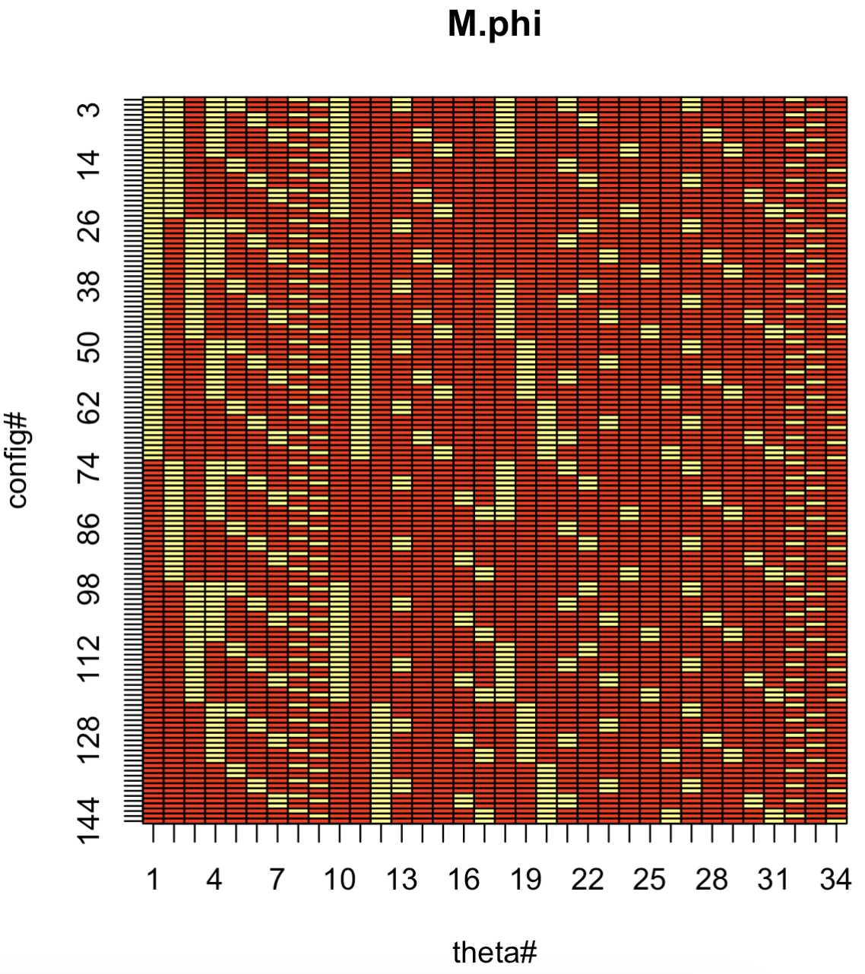
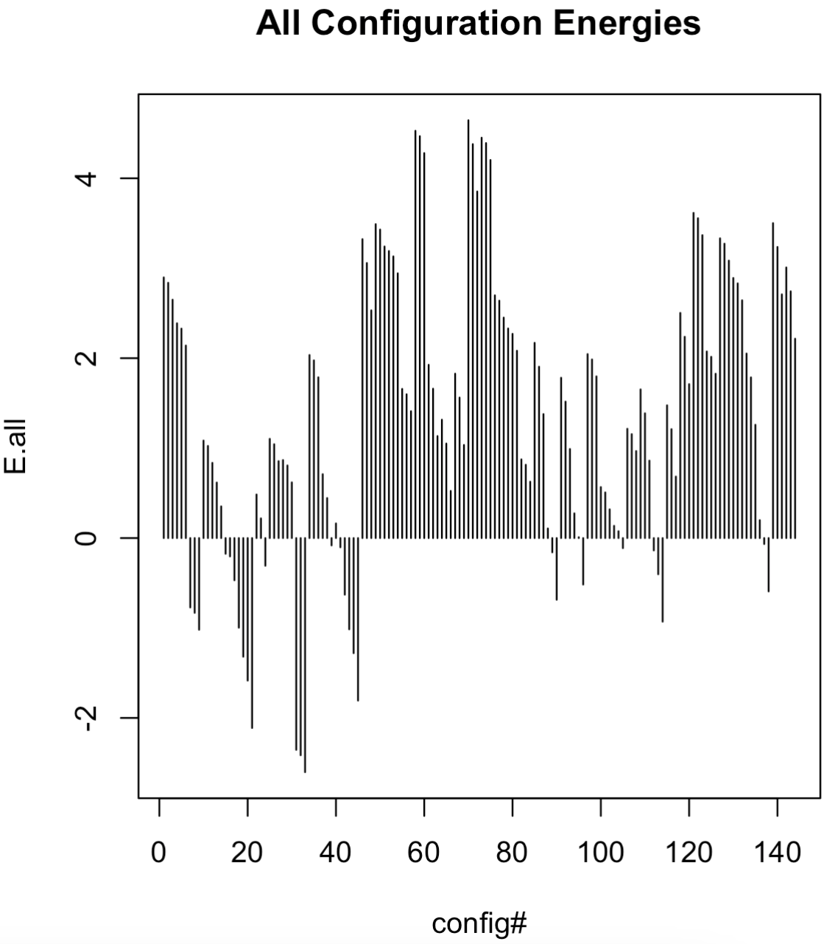
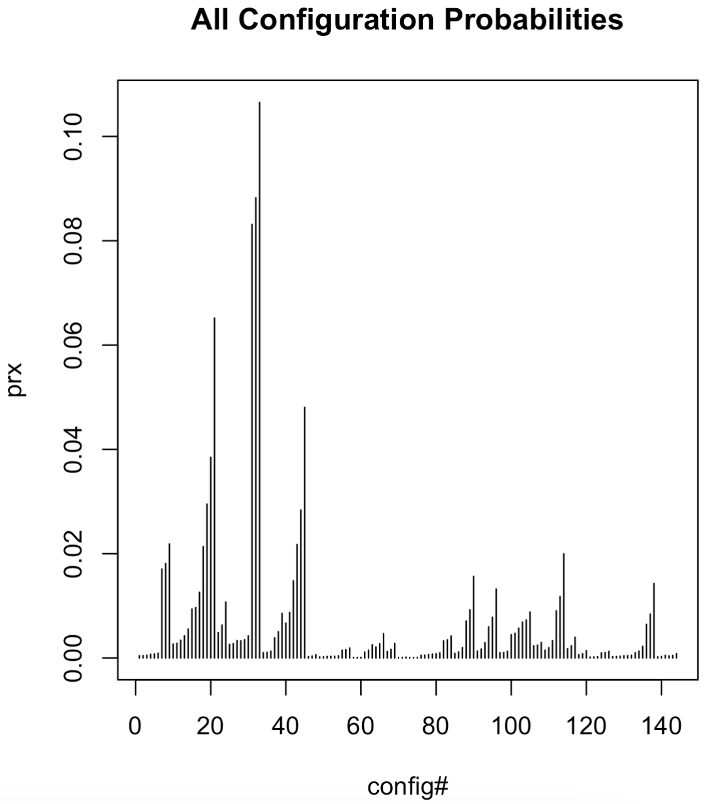
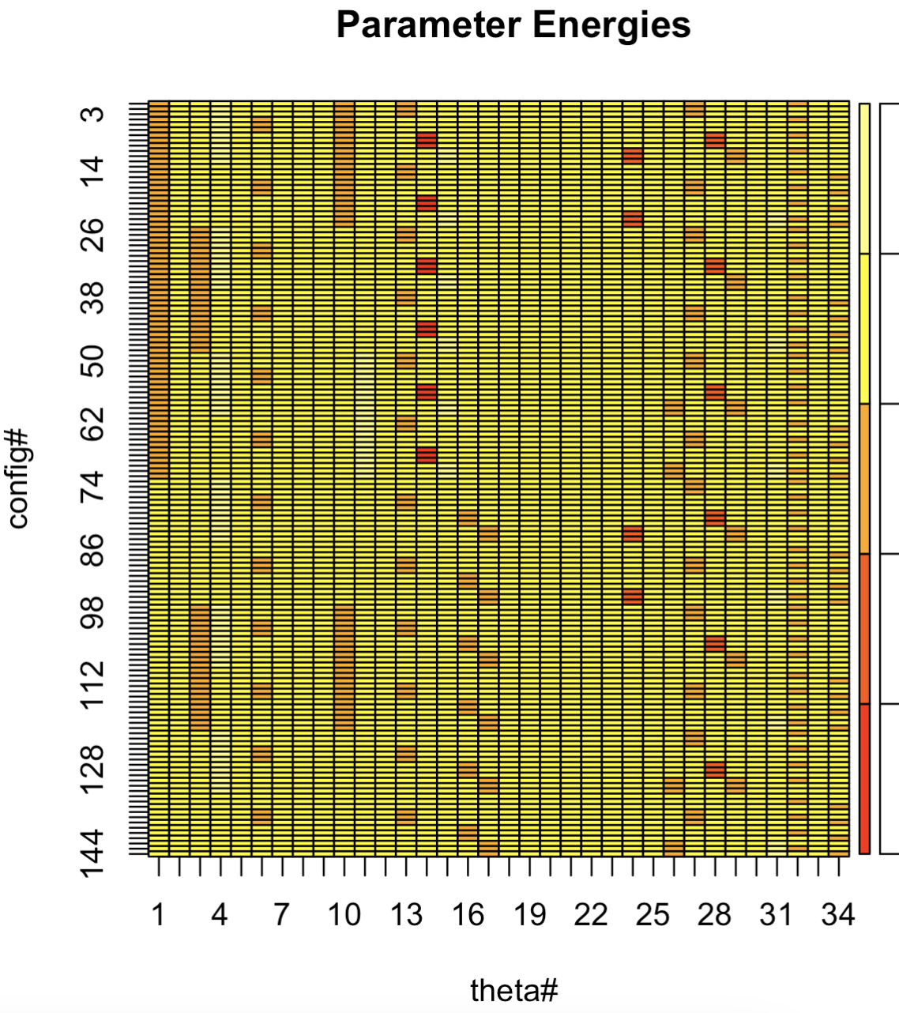
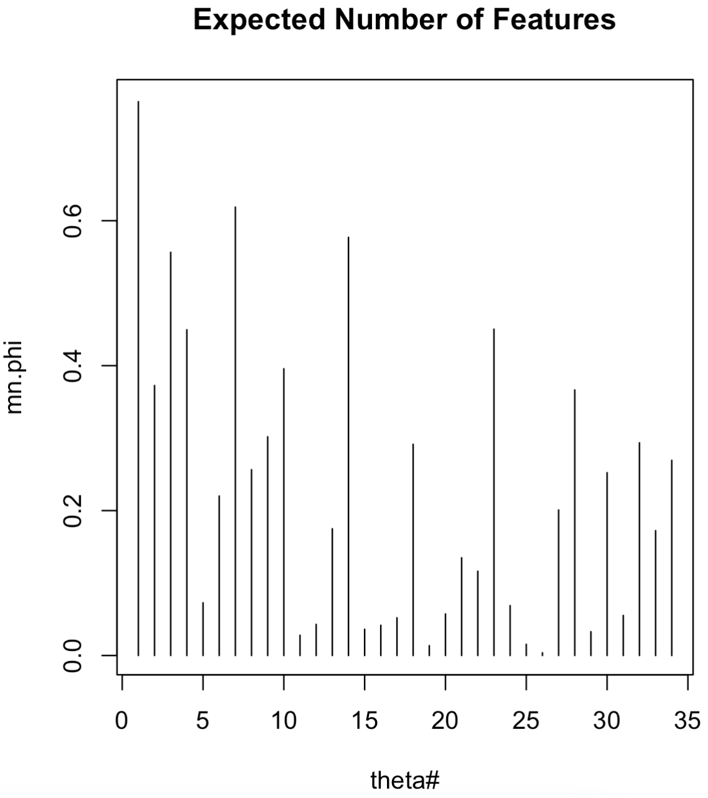
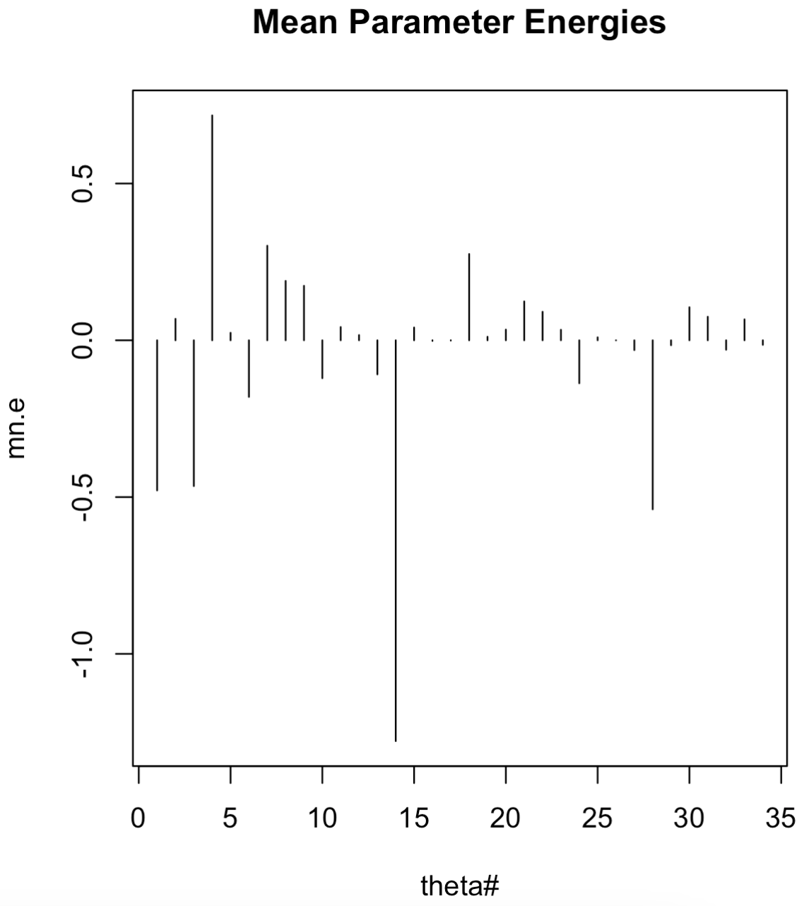
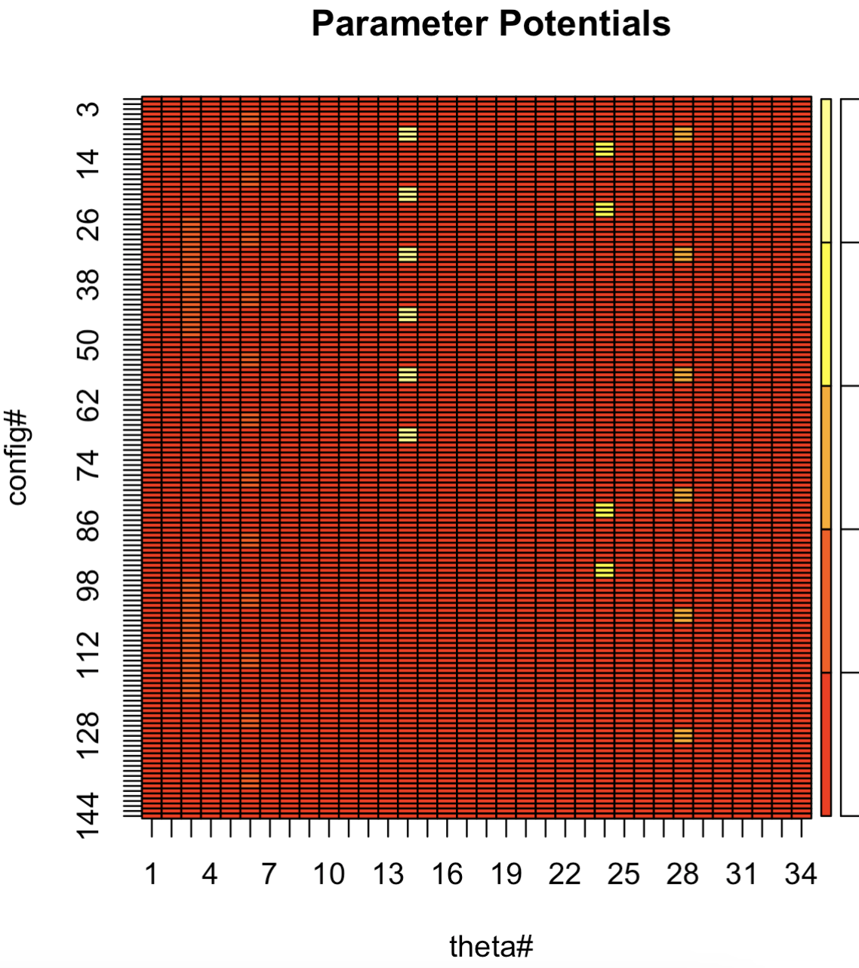
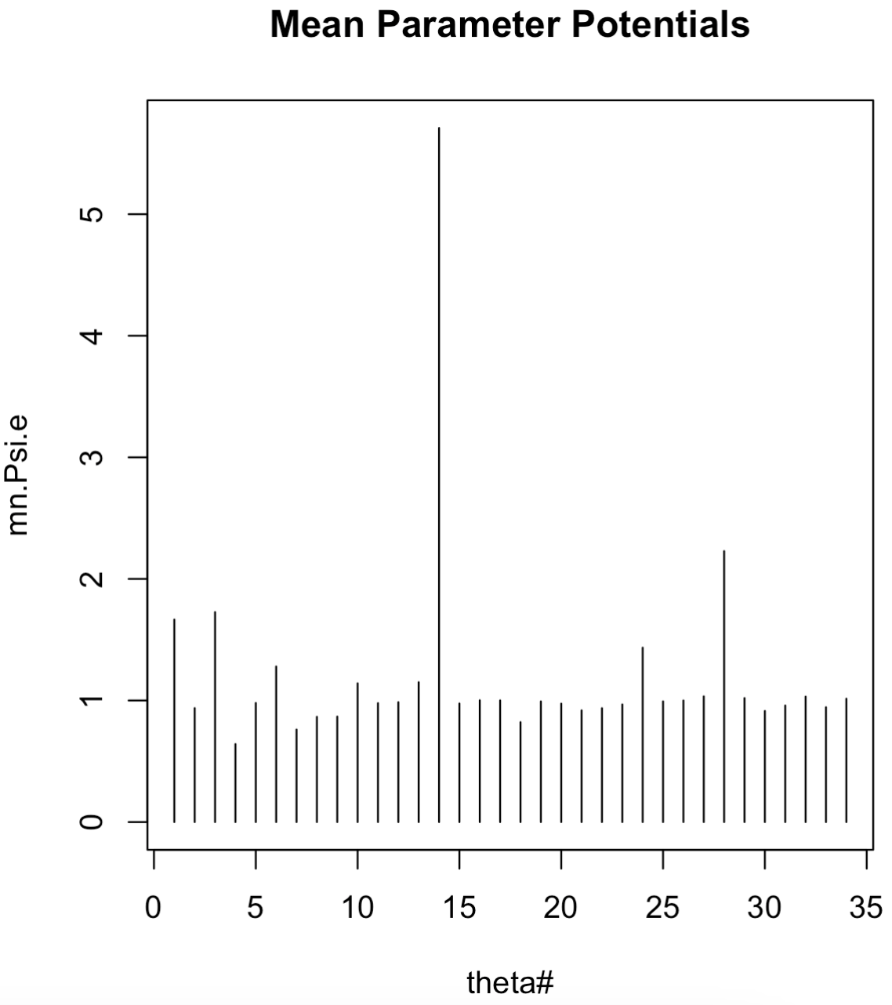
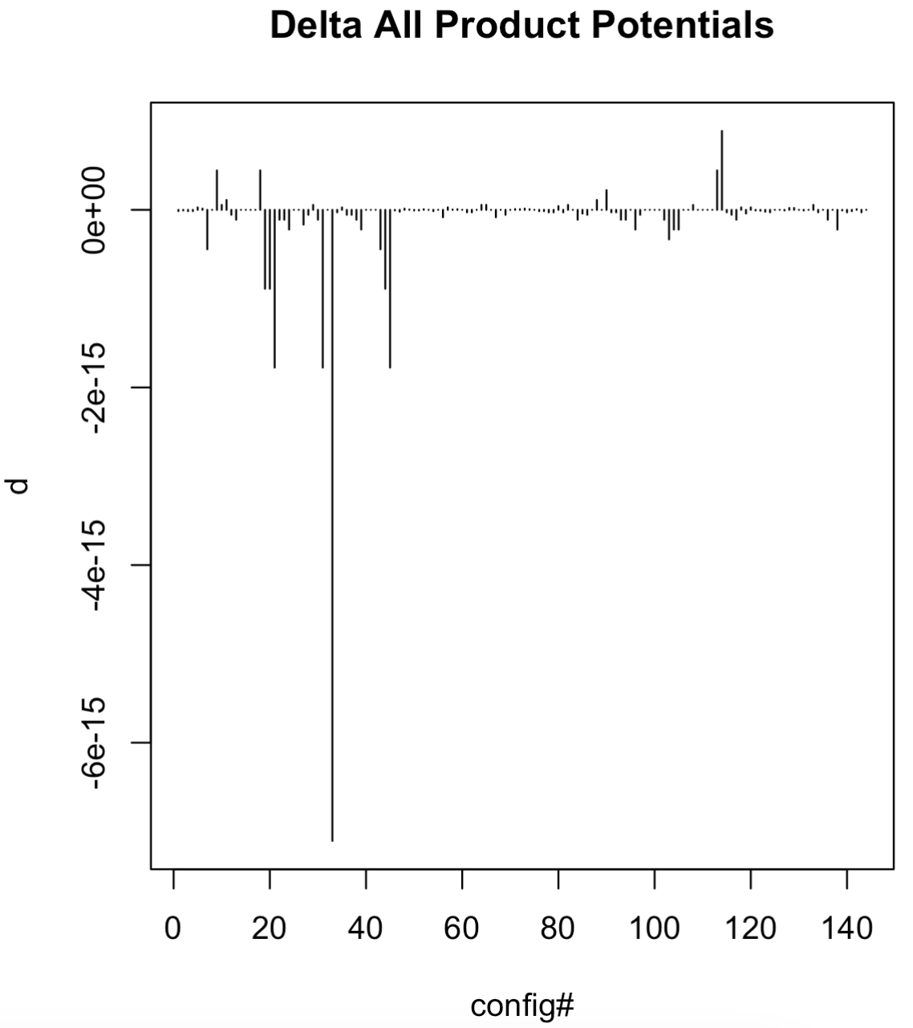

Slide 87
Maximum Likelihood Estimation

Slide 88

Under MLE we find the that maximizes :
The problem is we don’t know Z when we start the calculation…
We can solve the problem iteratively by re-computing Z after each time we adjust in the process of reaching
Z is prohibitive to re-compute for large networks, but we’ll use this method anyway.
We need to be careful not to let let the networks get too big…
Before we explore how to implement this maximization, lets explore s in a tad more detail and define what we’ll call a “feature” φ_{k}(X).

